Slide 1

AASC Lesson 1.3: Ground Sign Awareness
Notes:
Find guidance inserted in the note section of each slide.

Slide 2

Overview
1.3.1 Introduction to GSA
1.3.2 Why Things are Seen
1.3.3 GSA Characteristics
Notes:
Note: confused about the paragraph number. Should it be 1.3.3 instead of 2.3.1?

Slide 3
Terminal Learning Objectives
At the end of this module, the participants will be able to recall the characteristics of sign and understand how recognizing ground sign may be used as a tool to identify IEDs.
Notes:
May? Or can be used. Ground sign awareness is to important so in my opinion they need to differentiate the characteristics.
Note: in real life training I have the experience of noticing the threat before using my equipment all on ground sign.

Slide 4
2.3.1 Introduction to GSA

Slide 5
What is Sign?
Sign: Any evidence of change inflicted upon the natural state of the environment by the passage of man, animal or machinery.
Ground Sign is therefore sign that occurs on or around the ground.
Ground Sign Awareness is the understanding of ground sign and the ability to apply it in order to identify potential threats, namely the threat of IEDs or IED perpetrators.
Ground Sign Awareness is the individual skill to interpret changes in the environment
5
Notes:
“Sign” is described as any evidence of change inflicted upon the natural state of the environment by the passage of man, animal or machinery.
Ground Sign is therefore sign that occurs on or around the ground.
Ground Sign Awareness is the understanding of ground sign and the ability to apply it in order to identify potential threats, namely the threat of IEDs or IED perpetrators.
Ground Sign Awareness is the individual skill to interpret changes in the environment.

Slide 6
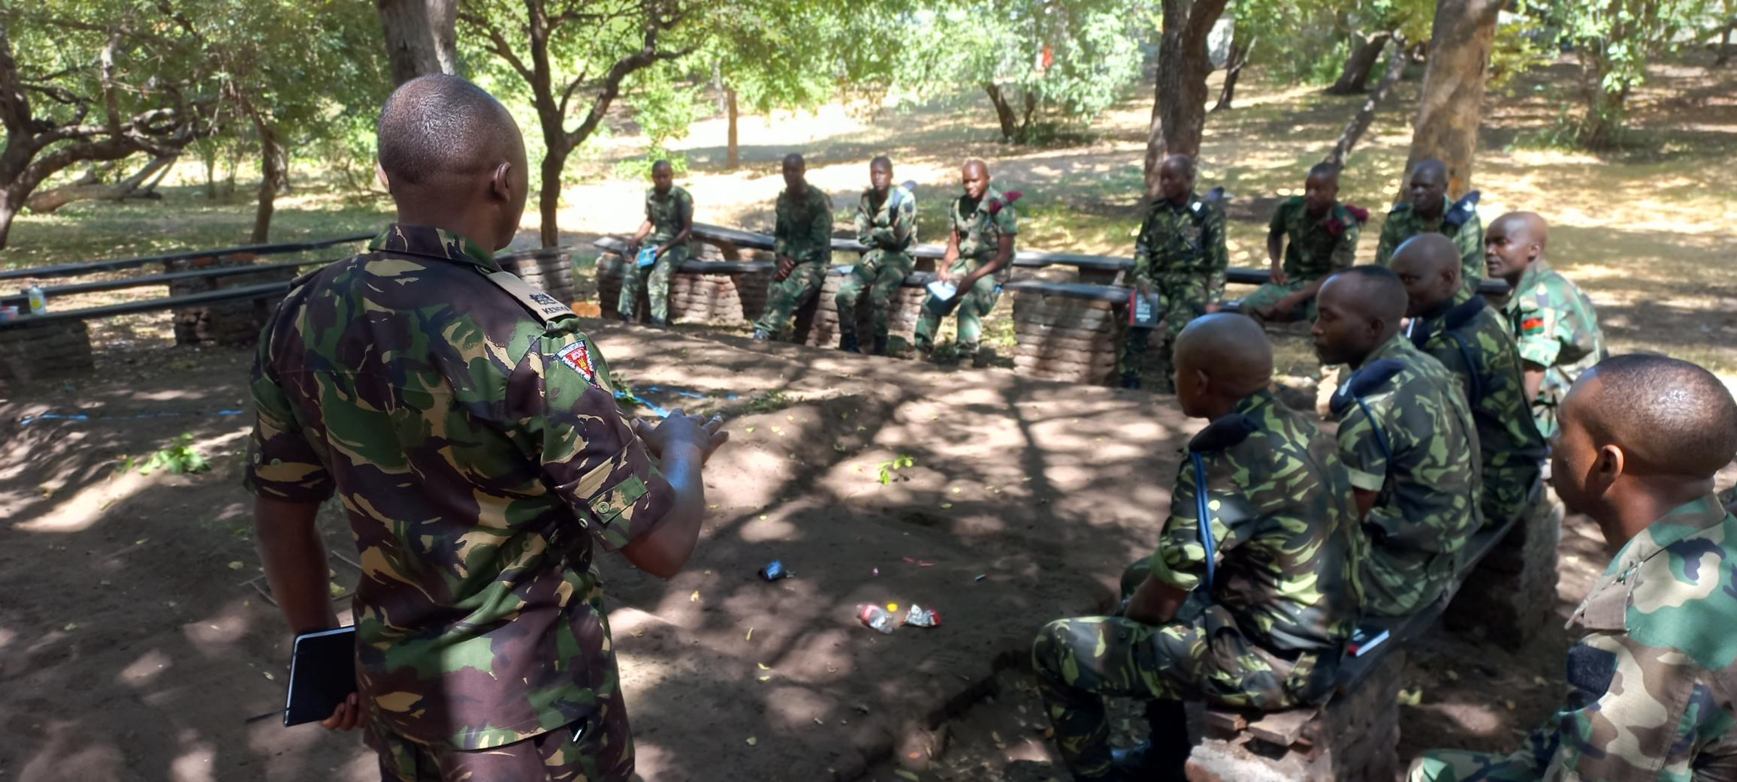
Why is it Important?
6
Notes:
The ability to identify and interpret ground sign is an element of tracking however it is a basic fieldcraft skill that all soldiers should possess. Soldiers should be able to use any means to gain as much information about the enemies methods and where possible identify changes to the environment that can provide a combat indicator to preempt a dangerous situation.
Through the use of Ground Sign Awareness all soldiers should be able to interpret sign left by an adversary. It can be adapted for use in any theatre and is especially effective when used in the CIED environment.
Image courtesy Jordan Sorabjee

Slide 7

Why is it Important?
Most IEDs found using GSA alone
A skill that require no specialist equipment
Can be used by anyone
Can be used in all operating environments
7
Notes:
Why is GSA important? The vast majority of IEDs (in some estimates as much as 80%) that are found, are discovered not through the use of specialist equipment, but through sight alone. It is not the sighting of the IED itself, but the change it imposes on the environment resulting in the ground sign being visible. So why is this important? This means the single greatest tool for finding IEDs is through the use of GSA. More importantly, it is a tool that does not require any specialist equipment and it can be easily taught to all troops and police.

Slide 8
2.3.2 Why Things are Seen

Slide 9
Why Things Are Seen
The 7 Ss
Shape – Familiar shapes recognized easily, Contrast with natural surroundings
Silhouette – Object silhouetted against contrasted background
Shine/Texture – Surface that contrasts with its surroundings
Shadow – Cast/contained
Spacing – Natural objects are never regularly spaced
Sudden Movement – The eye is attracted to movement
Signature – Thermal out put of objects
Notes:
Ground Sign Awareness is built upon basic military skill. As a soldier we learn how to camouflage ourselves and our equipment by understanding why things are seen in the environment. Knowing why things are seen help us to know how to conceal ourselves better. It also helps us to find things in the environment. The 7 S’s is a useful way to understand why things are seen. The 7 S’s are:
Shape – Familiar shapes recognised easily, Contrast with natural surroundings
Silhouette – Object silhouetted against contrasted background
Shine/Texture – Surface that contrasts with its surroundings
Shadow – Cast/contained
Spacing – Natural objects are never regularly spaced
Sudden Movement – The eye is attracted to movement
Signature – Thermal out put of objects
Note: Is it possible for this slide show to provide pictures that show the audience what is meant by the 7’s because not everyone has the ability to understand what is meant by shine ( example picture of a mirror reflecting in the background).

Slide 10
Methods of Observation
There are two methods used to see things.
Scanning – general & systematic examination of an area in order to detect anything out of the norm
Searching – a thorough examination of specific features in the area
Both require concentration & a knowledge of both Why Things Are Seen and the principles of camouflage & concealment
Notes:
As well as knowing why things are seen, we can use practical methods to help us find things in the environment.
There are the two methods used to identify adversarylocations.
Scanning – general & systematic examination of an area in order to detect anything out of the norm
Searching – a thorough examination of specific features in the area
Both require concentration & a knowledge of both Why Things Are Seen and the principles of camouflage & concealment.
Note: with methods of observation it is not specifically used to identify enemy locations but rather to be used in area’s in the direction of VA’S OR VP’S and IED’S. discussion?
Also pictures by what is meant with scanning en searching. Do instructors provide an example?
Equipment? : binoculars

Slide 11
2.3.3 GSA Characteristics

Slide 12
GSA Characteristics
GSA has six characteristics:
Disturbance
Regularity
Discardable
Flattening
Transfer
Colour changes / Discolouration
12
Notes:
GSA generally has six characteristics. These are:
Disturbance
Regularity
Discardable
Flattening
Transference
Colour changes / Discolouration
We will now look at each characteristic in some more detail.

Slide 13
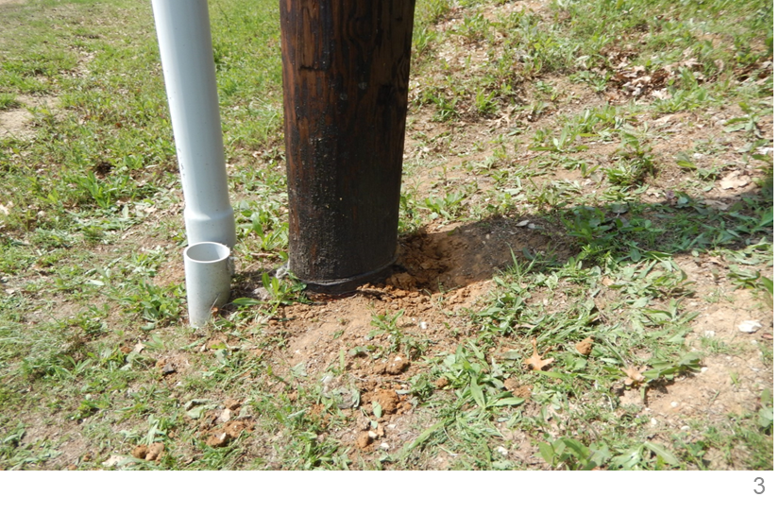
Disturbance
GSA Characteristics
13
Notes:
Disturbance is any evidence of change or rearrangement from the natural state caused by passage of target. When an IED has been emplaced by digging, it causes a disturbance to the natural pattern of the earth.
Image – Disturbed soil at the base of electricity pole. Courtesy UK MOD.

Slide 14
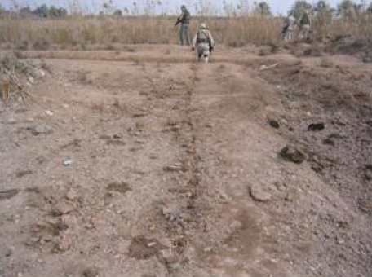
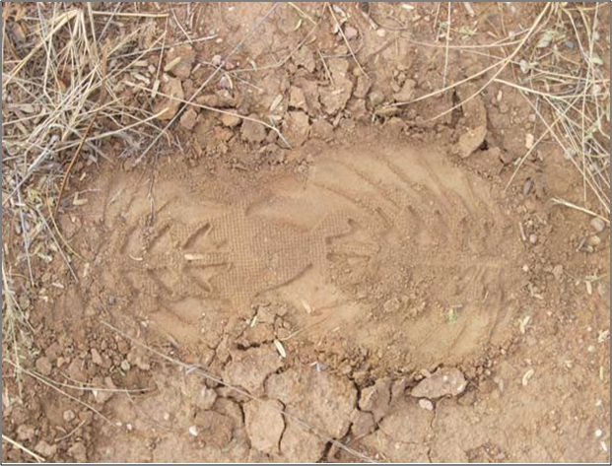
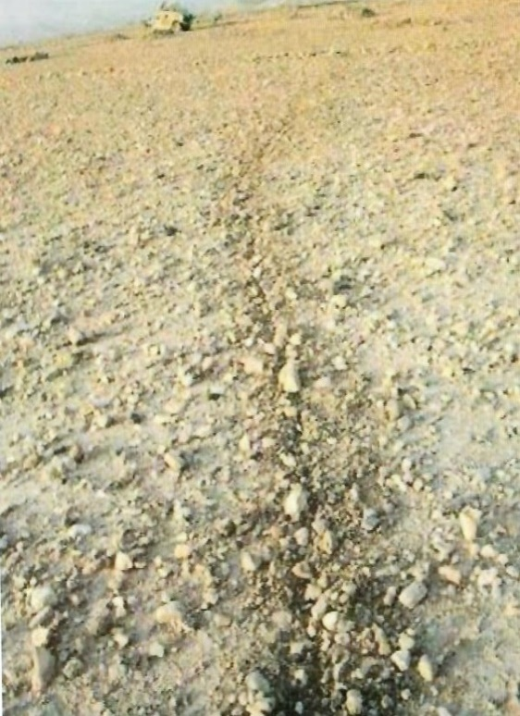
GSA Characteristics
Regularity
14
Notes:
Regularity is an effect caused by straight lines, arches and other geometric shapes. It’s hard to find straight lines occurring naturally.
When the IED emplacer emplaces and tries to conceal an IED some things will look out of place compare to the surrounding area.
These lines may not necessary appear to be only straight but could also be circular rectangular or square shaped which may reveal the outline of the IED.
Image Left – Regular patterns of a shoe print. Courtesy UK MOD
Images Right – straight line caused by digging in of command wire. Courtesy UK MOD

Slide 15
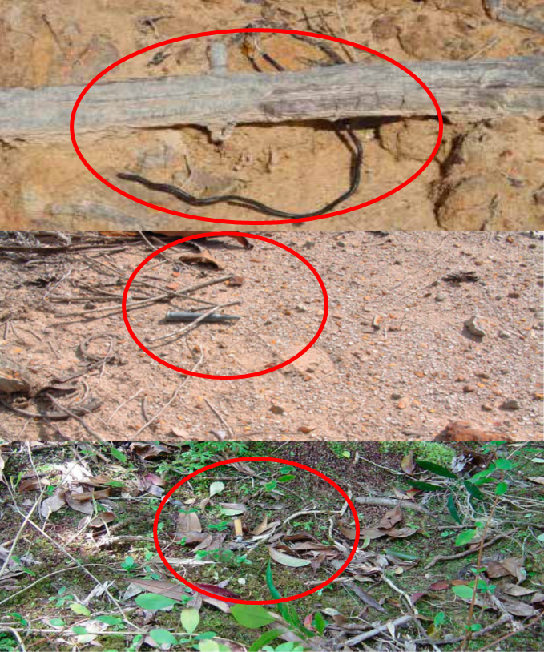
GSA Characteristics
Discardables
15
Notes:
These items maybe intentionally or unintentionally left behind at the emplacement site of an IED. Common items left behind are wire ends, or bits of tape when connecting the power source of the IED.
Images Courtesy UK MOD

Slide 16
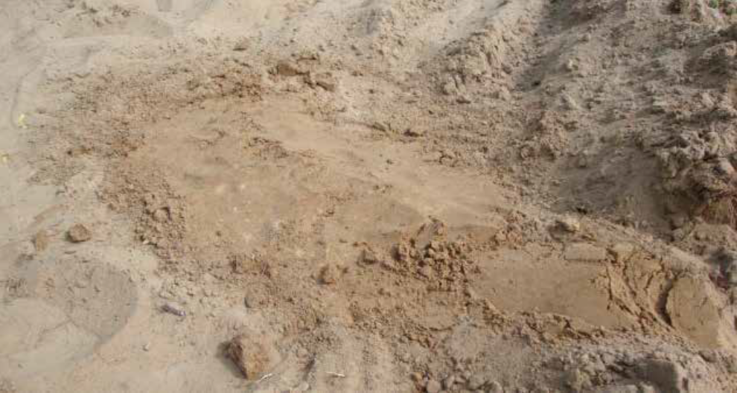
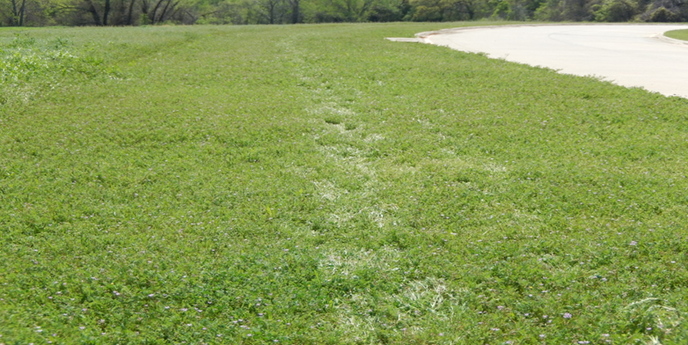
GSA Characteristics
Flattening
16
Notes:
Flattening is the general levelling or depression, identified by comparison with immediate surrounding.
Images Courtesy UK MOD
Example. They used a shovel to flatten the surface upon the IED.

Slide 17
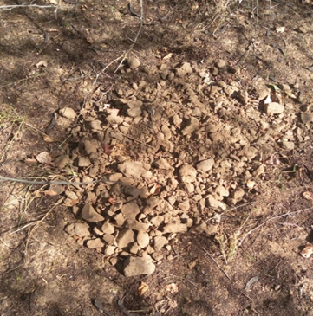
GSA Characteristics
Transfer
17
Notes:
Transfer is the transit of material from one environment to another.
Image source unknown
Example: different types of ground used to camouflage and concealment.

Slide 18
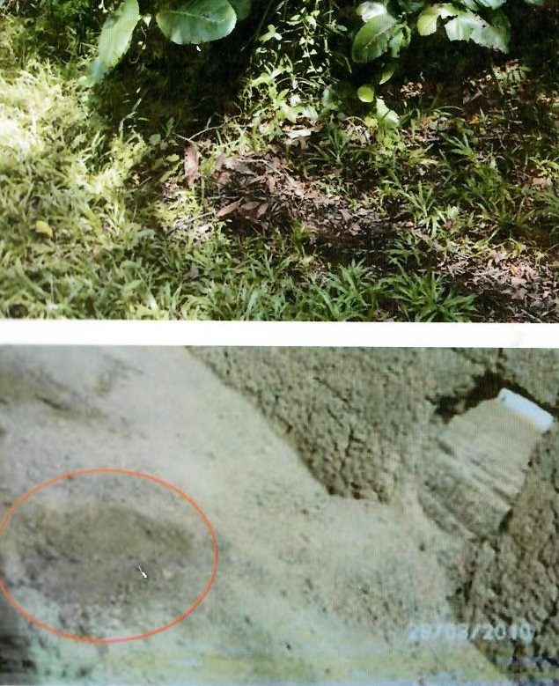
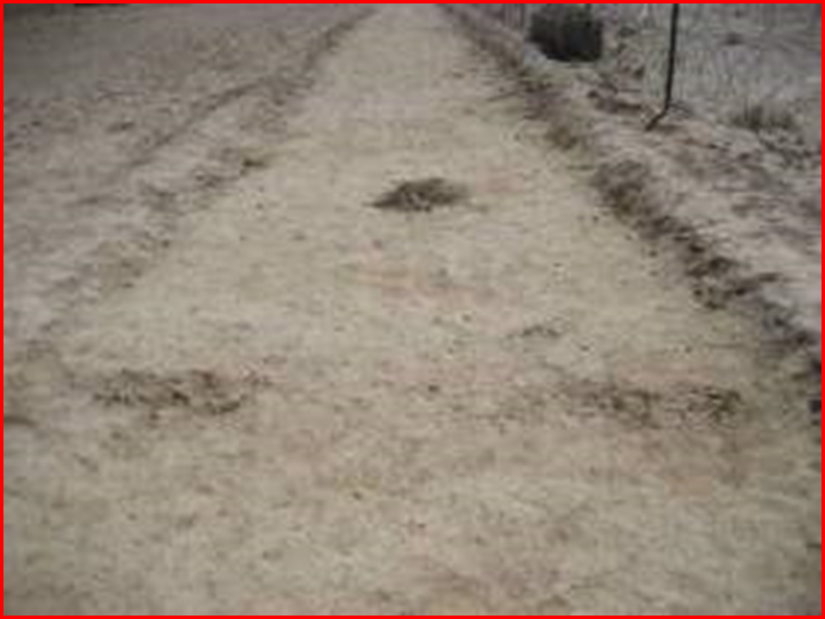
GSA Characteristics
Colour Change
18
Notes:
Difference in colour or texture from an area that surrounds it.
Images Courtesy UK MOD

Slide 19

GSA Considerations
General Considerations for GSA:
GSA is a skill that requires practice and needs to be maintained.
Environment specific
“Tuning In”
19
Notes:
There are some general consideration for GSA. Firstly, GSA is a skill. It can be practiced and improved but it needs to be practiced in order to be maintained. If you are in an environment in which you only deploy onto the ground once a week or there have been a long gap since last patrol, GSA needs to be refreshed. Luckily it is a skill that can be trained using very little resources. Secondly, developing GSA in one environment wont make that skill applicable in another. You need to practice in the environment in which you are operating in. this is because everything including the soil and vegetation will vary and show GSA in a different way. Further more, the types and ways IEDs are employed will vary and so the way the sign will indicate will vary too. This is why we say there is a bit of time required to tune into a new environment. This is to say it will take a few days or weeks to start to fully understand the environment and be able to identify ground sign. Understanding of the characteristics is therefore important to be used when on different types of searches.

Slide 20
Factors which affect sign
There are 4 factors that can influence sign.
These can be a benefit or a hinderance.
So what are these factors?
Factors of influence:
1. Traces of man
2. Terrain
3. Climatic conditions
4. Time
Notes:
1. Traces of man:
Footprints and use of vehicles. Animals can also affect the sign so be aware of the difference.
2. Terrain:
Having information of the environment that you operate such as grasland, sand, rocks, snow and wet places.
3. Climatic conditions:
The sun, wind and rain influences the AO. ( Instructors need to provide examples ).
4. Time:
Time is split into hard sign and soft sign. Hard sign is prints of mos, or stones. The reasons is that the sign takes longer for nature to go back to its normal state.
For the soft sign its quicker to go back to its own state. For example prints in mud, sand and snow wil go back to its normal state as it was before.
( instructor needs to provide example).

Slide 21
Questions for you
What are the six characteristics of GSA?
Disturbance
Regularity
Discardables
Flattening
Transfer
Colour changes / Discolouration
Leave it out? Let the students answer these questions.
(powerpoint)
21
Notes:
There are some general consideration for GSA. Firstly, GSA is a skill. It can be practiced and improved but it needs to be practiced in order to be maintained. If you are in an environment in which you only deploy onto the ground once a week or there have been a long gap since last patrol, GSA needs to be refreshed. Luckily it is a skill that can be trained using very little resources. Secondly, developing GSA in one environment wont make that skill applicable in another. You need to practice in the environment in which you are operating in. this is because everything including the soil and vegetation will vary and show GSA in a different way. Further more, the types and ways IEDs are employed will vary and so the way the sign will indicate will vary too. This is why we say there is a bit of time required to tune into a new environment. This is to say it will take a few days or weeks to start to fully understand the environment and be able to identify ground sign.
Note: This same text is also used in slide 19 and I would leave out the characteristics and just ask the students ; what are the characteristics ? Let the students come up with the answers themselves and lets see what they have picked up from the other slides.

Slide 22
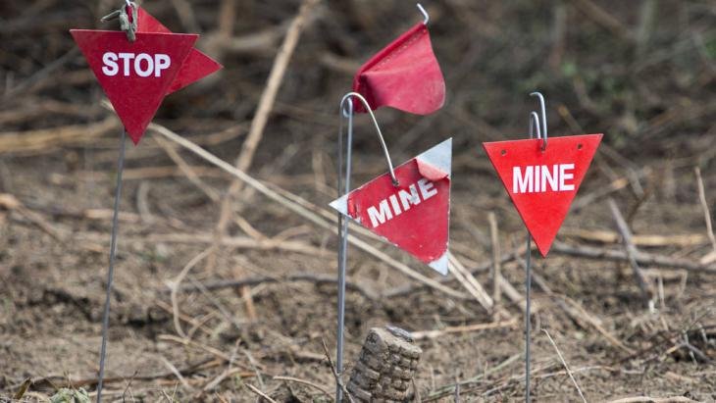

Questions?
Notes:
Do we need a slide to explain wich are the factors that affect sign?
Thinking about factors of influence are:
Traces of man
Terrain
Climatic conditions
Time

